Slide 1
Merging

Slide 2
Merging
Merging two datasets is the process of bringing two datasets together into one, and aligning the rows from each based on common attributes or columns.
The words merge and join are used interchangeably in pandas.

Slide 3
Types of Joins
There are four types of joins in python:-
Inner join
Outer join
Left join
Right join

Slide 4
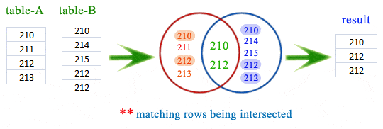
Inner Join
Inner join combines two dataframes based on a common key and returns a new dataframe that contains only rows that have matching values in both of the original dataframes.

Slide 5
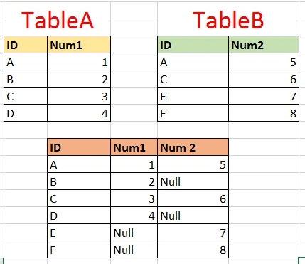
Outer Join
Outer join returns all those records which either have a match in the left or right dataframe.
When rows in both the dataframes do not match, the resulting dataframe will have NaN for every column of the dataframe that lacks a matching row.

Slide 6
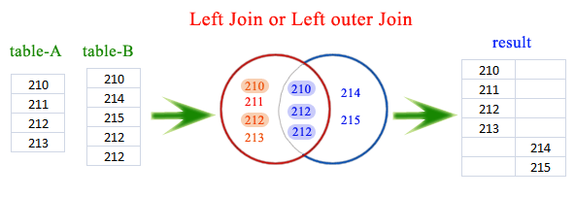
Left Join
Left join returns a dataframe containing all rows of left dataframe.
All the non-matching rows of the left dataframe contain NaN for the columns in the right dataframe.

Slide 7
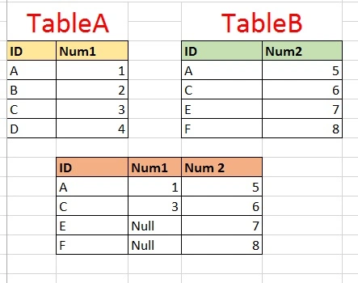
Right Join
Right join returns a dataframe containing all rows of right dataframe.
All the non-matching rows of the right dataframe contain NaN for the columns in the left dataframe.

